Slide 1

Spark forge
Learn what hackathons are, why people join them, and how they help you grow presented in clear, beginner-friendly language.

Slide 2

Objectives
Information
Competition
Real Experience

Slide 3
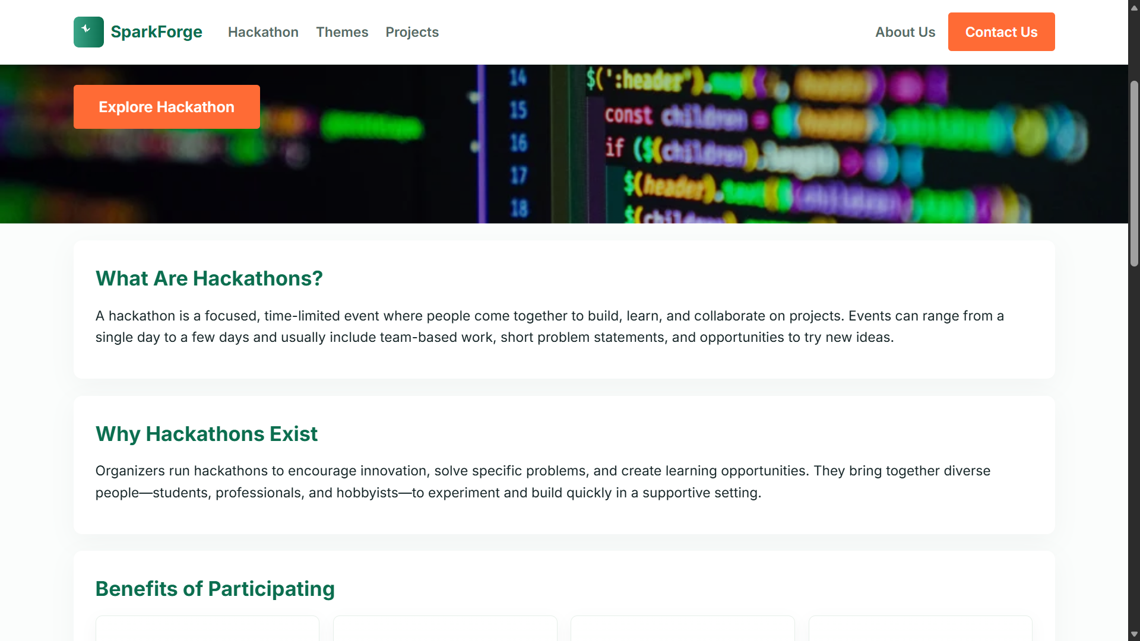
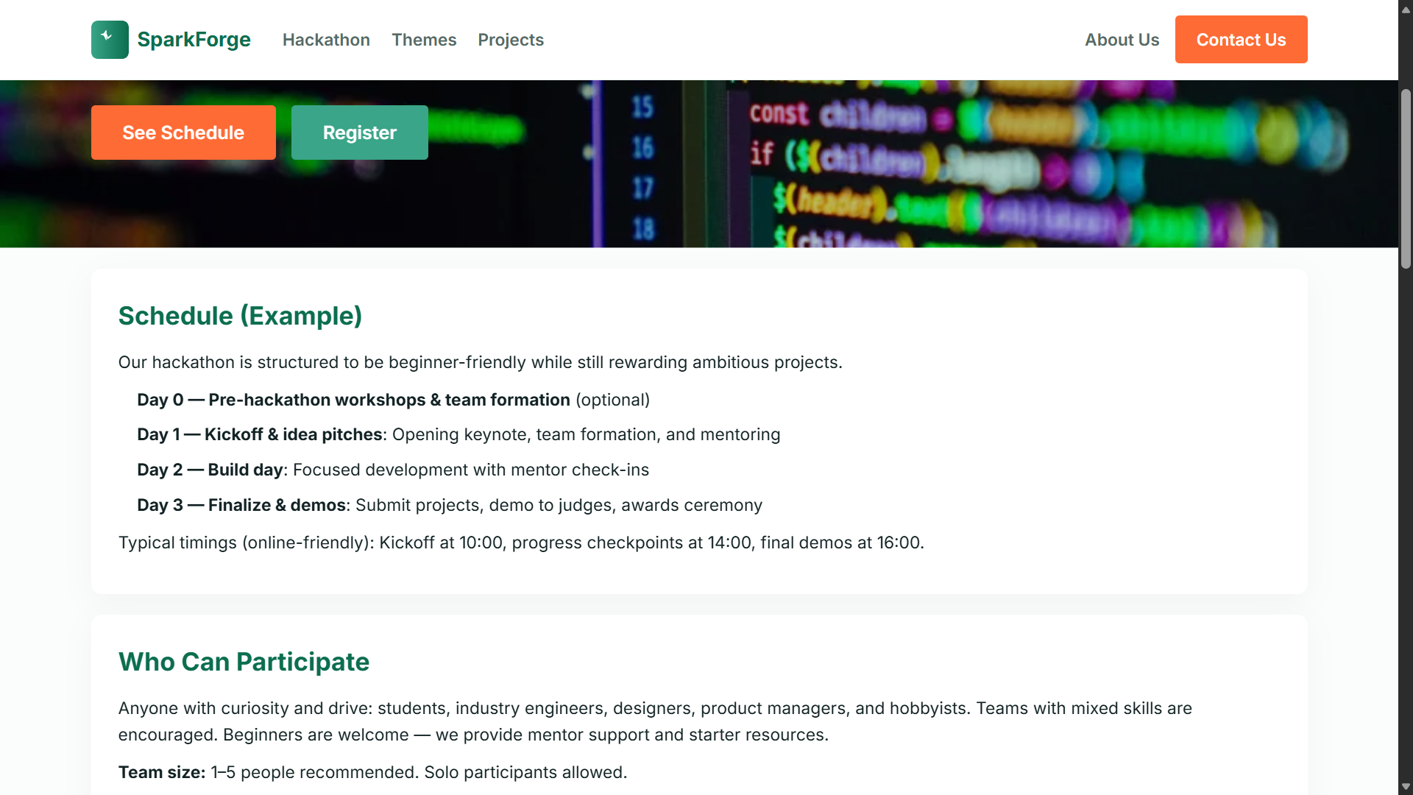
Web pages
Home page
Hackathon Info Page

Slide 4
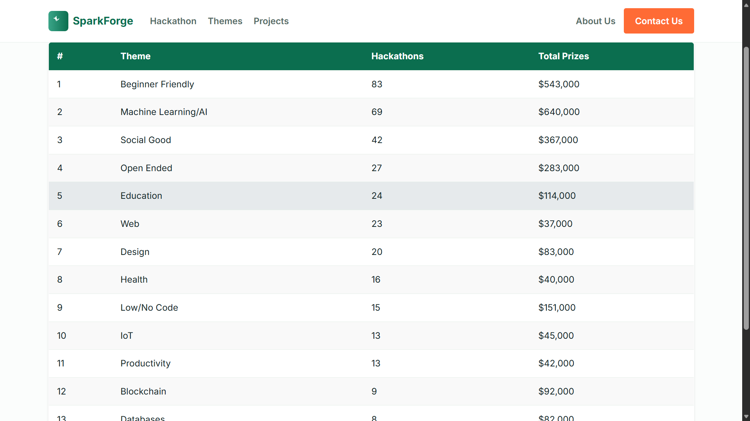
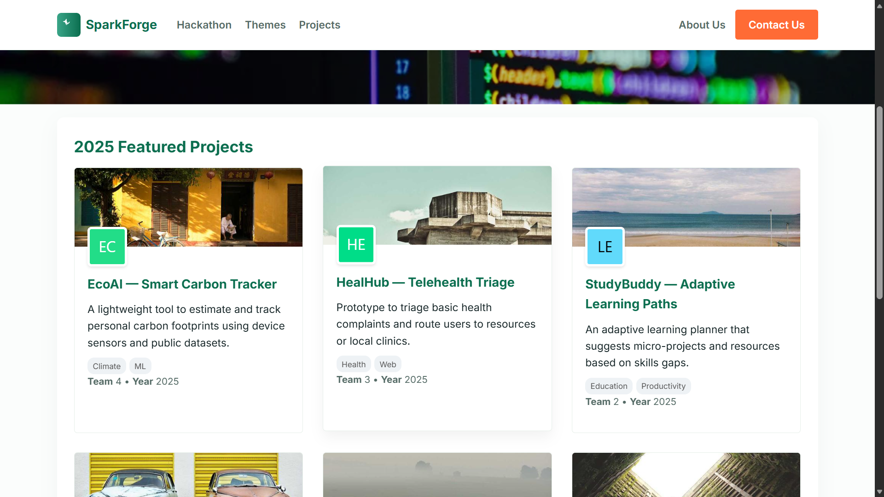
WEB Pages
Themes of Hackathons
Projects from previous Competetors

Slide 5
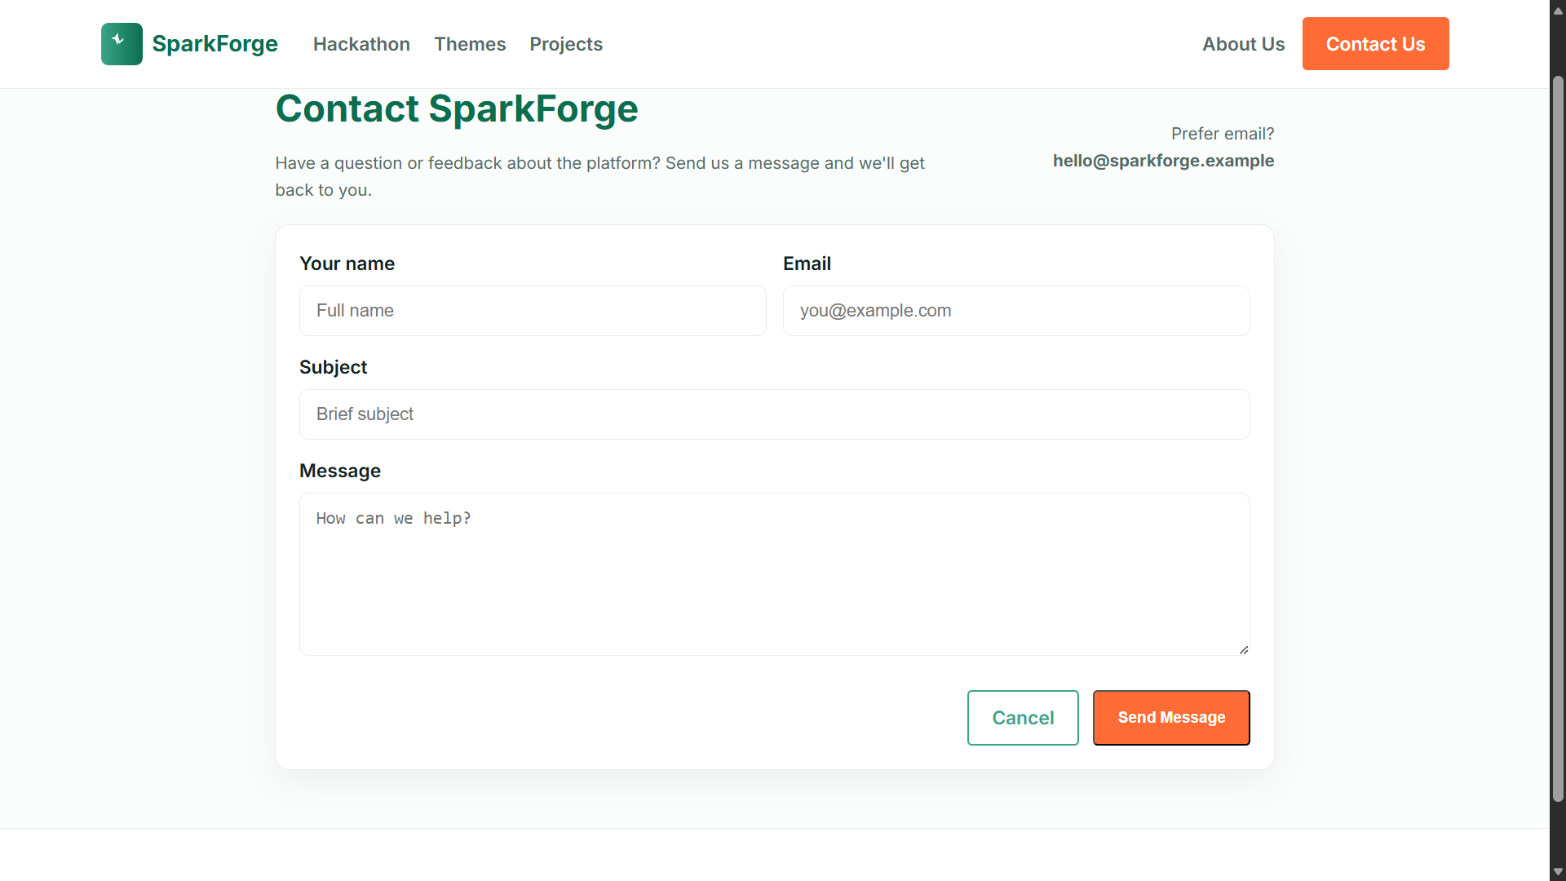
Contact us

Slide 6

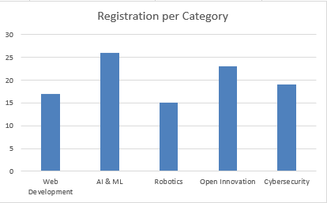
User data

Slide 7
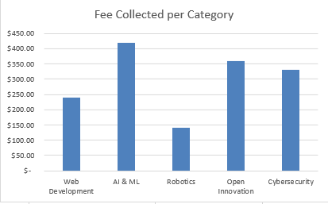
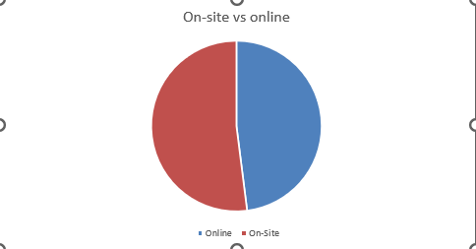
User data
Registration budgets and trends

Slide 8
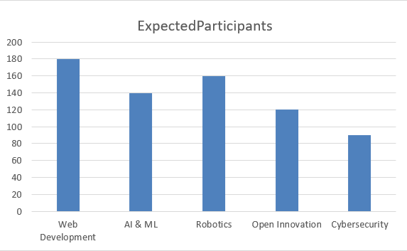
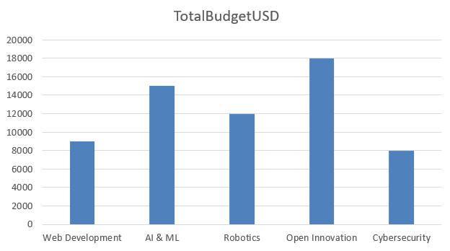
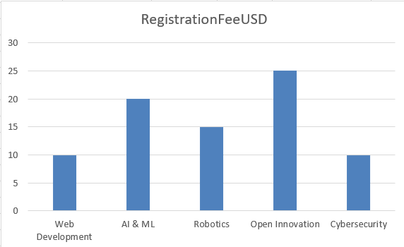
Maintainer Data
Expected Participants, total budget, registration fee

Slide 9




Live links
Repo
Video
Website

Slide 10
Reflection and next step
We want this site to expand to serve Pakistani engineers and learner to gain Real experience in Tech projects
Key Reflections
Next Step
Improved planning and structuring
Better data‑content alignment
Clearer academic documentation
Add interactive features
Implement backend integration
Expand real participant data

Slide 11

Thank You

